Slide 1

JIRA Integration
User guide

Slide 2
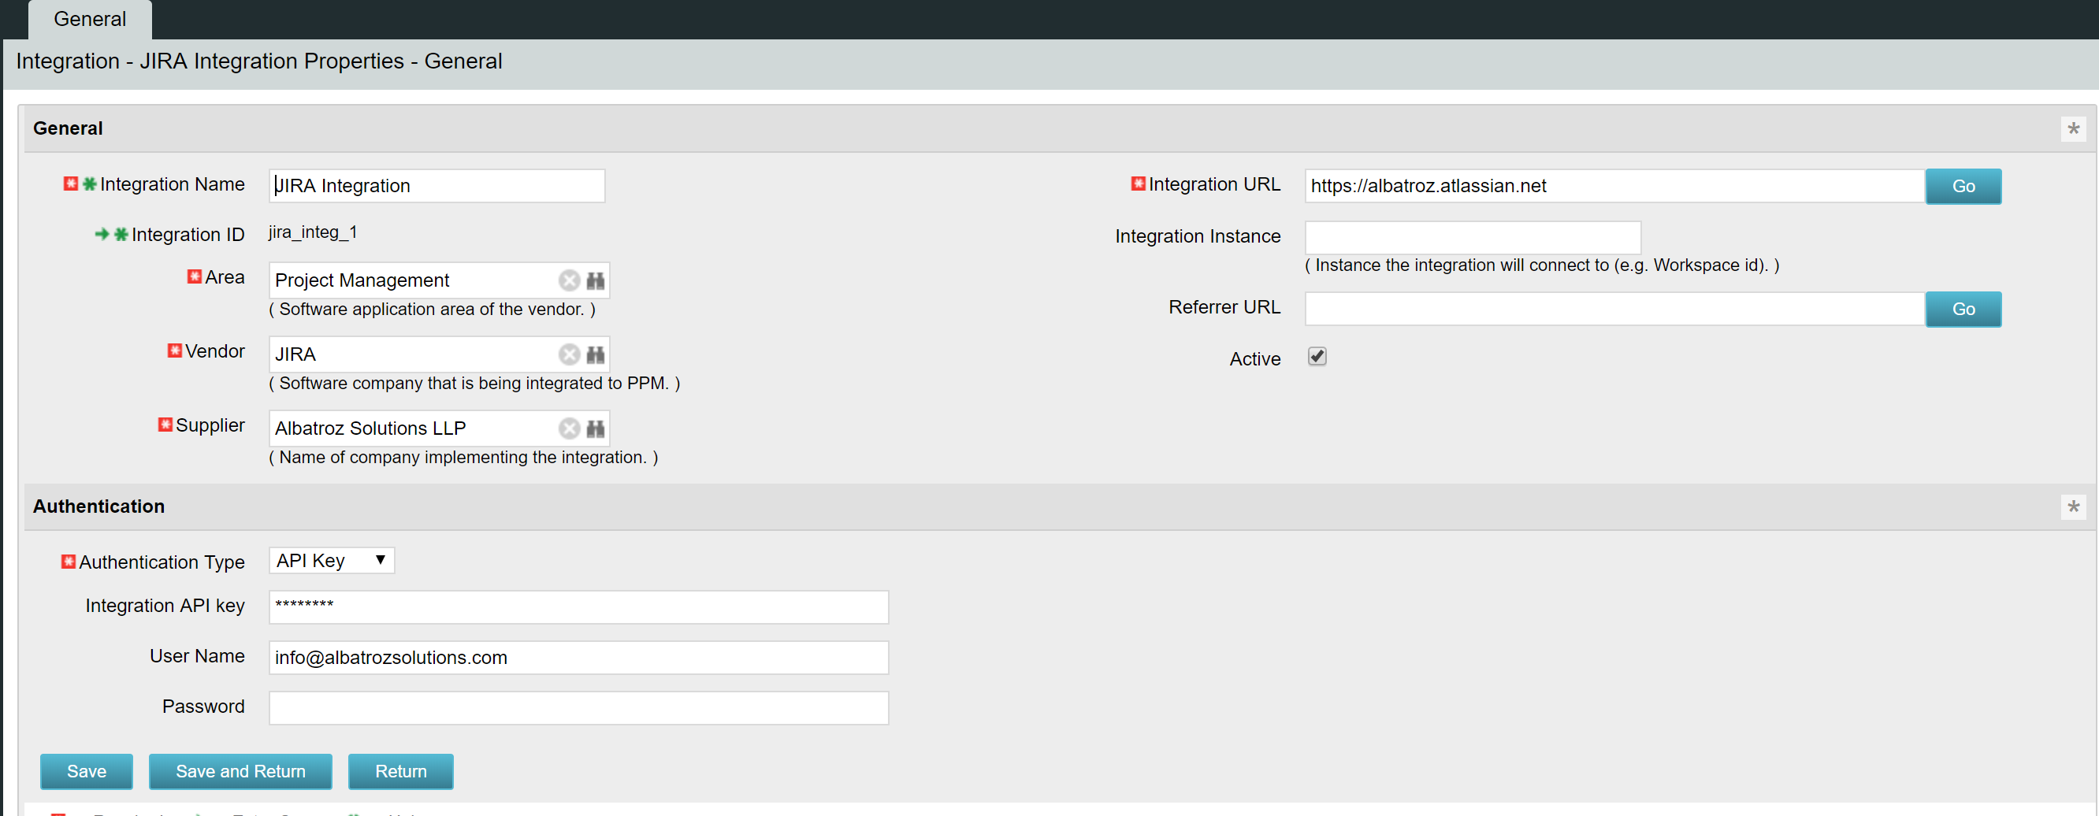
Defining integration connection
Create an instance under Administration -> Integrations with the
Integration ID to have the prefix of ‘jira’
For API Key based authentication choose API Key, for password based authentication choose BASIC

Slide 3
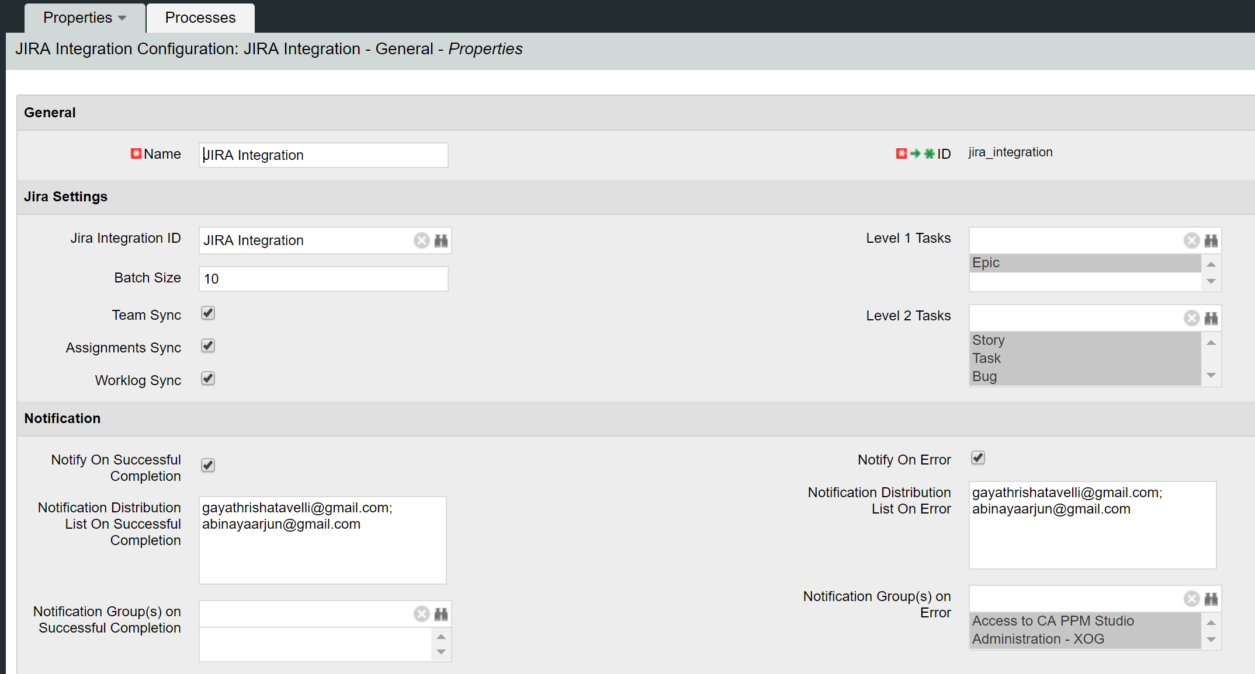
JIRA Integration – General properties
JIRA Integration instance would be created under Home -> JIRA Integration Configuration List
Select the JIRA connection instance
Select the JIRA issues to be mapped to Level 1 task in PPM
Team Sync – syncs the resources to project team
Assignment Sync – syncs the jira assignees to task assignments
Worklog Sync – syncs jira worklogs to PPM timesheets
Select the JIRA issues to be mapped to Level 2 tasks in PPM
Provide the email address or DLs who have to notified as semi colon separated list. Select the groups who have to be notified on completion or on errors

Slide 4
JIRA integration – Field mapping
Define the custom fields corresponding to the issues in JIRA that need to be synced with PPM
Custom field ID in JIRA
Intermediate feed object which store the JIRA data before the upload to PPM
Attribute ID of the feed object that stores the custom field data.

Slide 5
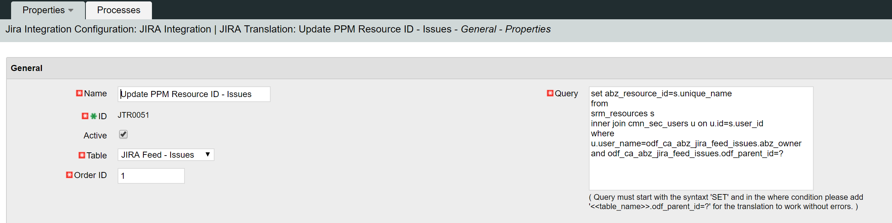
JIRA Integration – Translation
Translation rules modify the data retrieved from JIRA to make it PPM ready for upload. Translation rules are created as instances under the sub page – JIRA Translation Rules
Select ‘JIRA Feed – Issues’ if issues data has to be translated. Select ‘JIRA Feed – Worklog’ if worklog data has to be translated.
Translation Rules are executed based on the order # defined on them
Query to translate the data must follow the update statement syntaxt. The query must start with the keyword SET and in the where condition ‘<<tablename>>.odf_parent_id=?’ must be added. For issues, the table name is – odf_ca_abz_jira_feed_issues. For worklog, the table name is – odf_ca_jira_feed_worklog

Slide 6
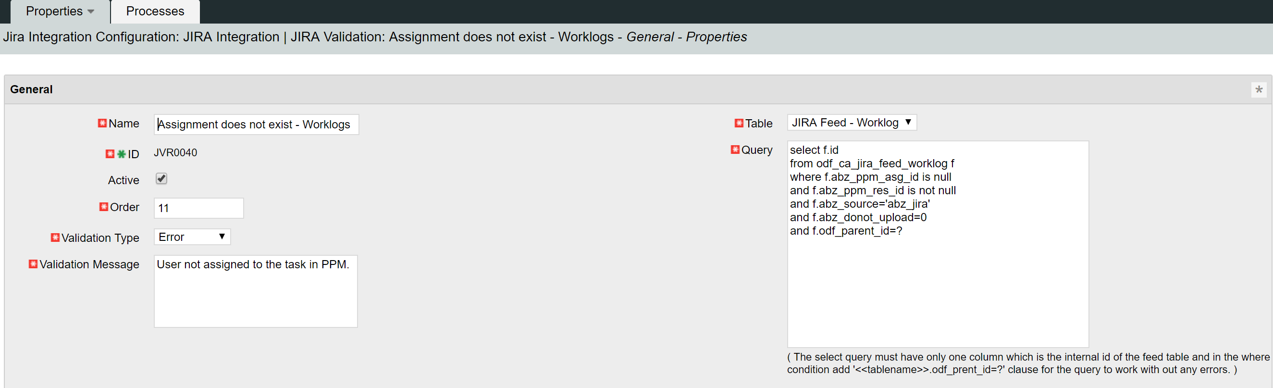
JIRA Integration – Validation
Validation rules check for the correctness of the before the upload to PPM is done to prevent any XOG errors. Issues with the data are listed to the end user for corrections.
Select ‘JIRA Feed – Issues’ if issues data has to be validated. Select ‘JIRA Feed – Worklog’ if worklog data has to be validated.
Validation Type error prevents the data record to be uploaded into PPM. The validation message must contain the error displayed in the portlets when the validation fails.
Validation query must follow the syntaxt of select statement. The internal id of the data row being validation must be the only column retrieved in the select statement. Where conditions must be used to validate the data for error scenarios and where condtion must have the clause ‘<<table_name>>.odf_parent_id=?’ While validating issue data the table_name must be odf_ca_abz_jira_feed_issues and while validation worklog the table_name must be odf_ca_jira_feed_worklog

Slide 7
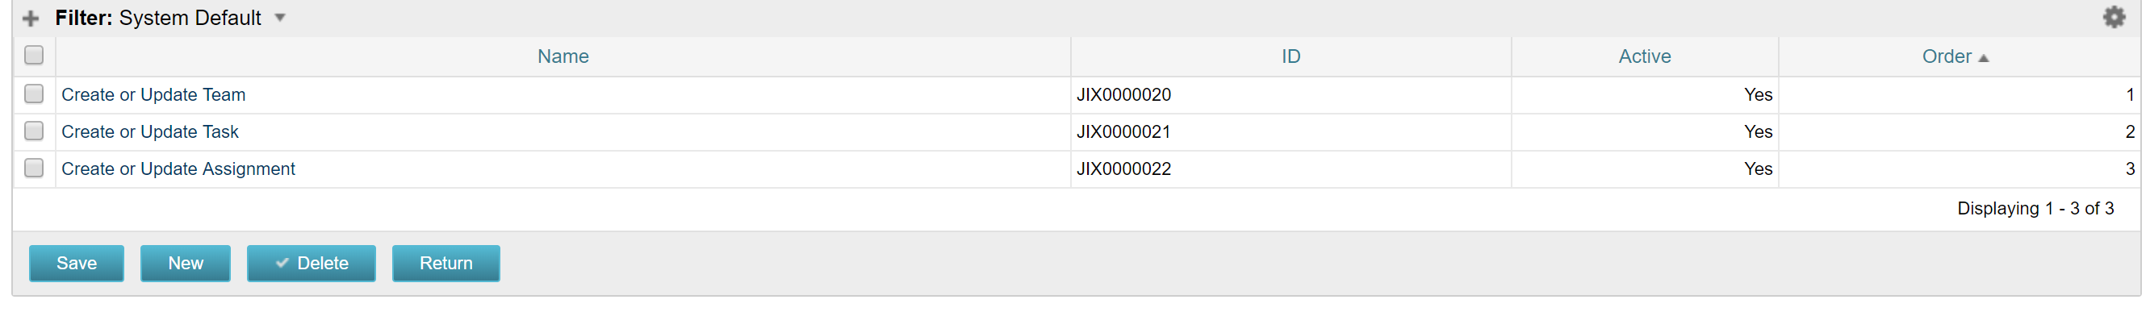
JIRA Integration - XOG
Data retrieved from JIRA is converted to xmls after translation and validation as per the XOG templates defined in the XOG layer.
Data corresponding to issues in JIRA is uploaded to PPM with the help of multiple xog xmls and corresponding to project team, task and assignments. Each of the xog template is defined as an instance in the JIRA XOG sub page.

Slide 8
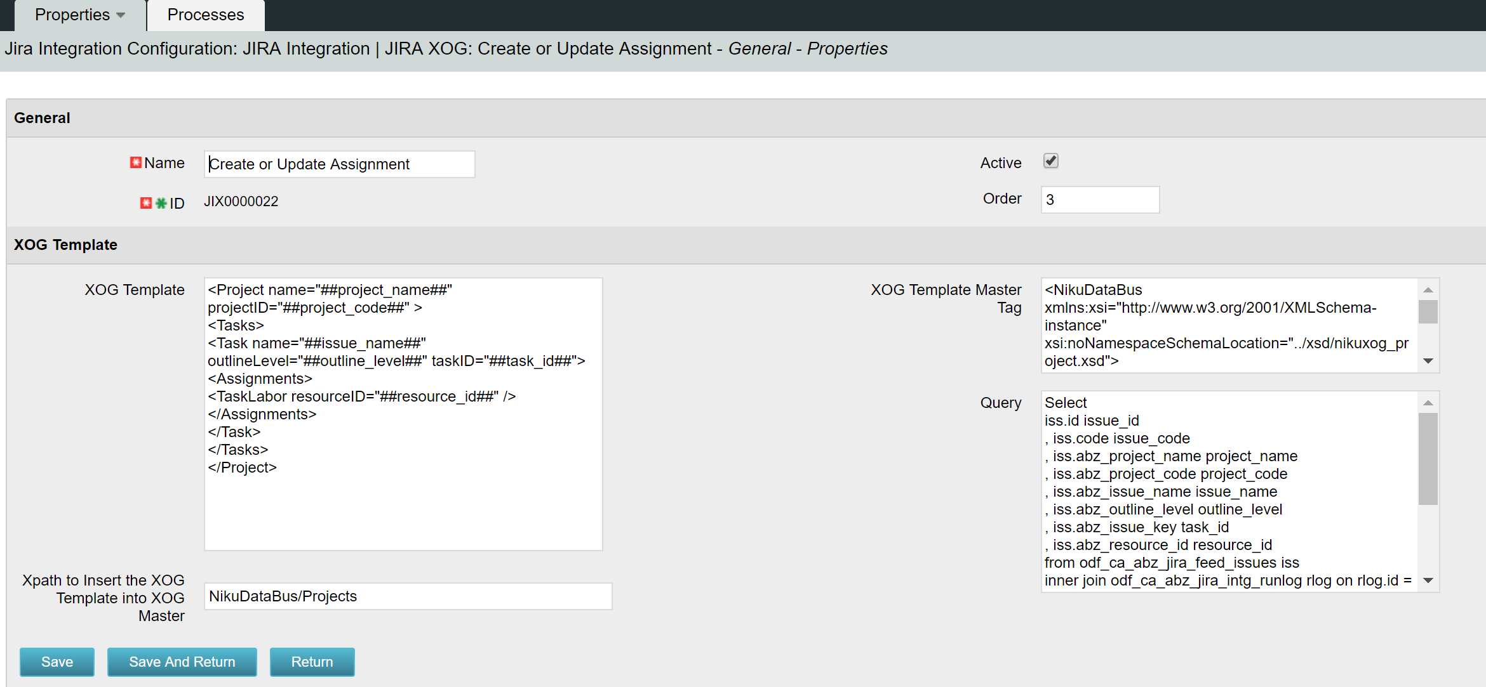
JIRA Integration - XOG
XOG xmls are created and xogged into the application based on the order defined on the xog instance.
XOG template that is used to generate xog xmls with the data retrieved from JIRA. The attribute values and node values in the template will be represented as ‘##columnalias##’ which will be replaced with the data retrieved by executing the query defined.
Query fetches the data columns necessary for the xog xmls from the intermediate tables holding jira data. The aliases defined on each column are used to map the data with the xog template defined.

Slide 9
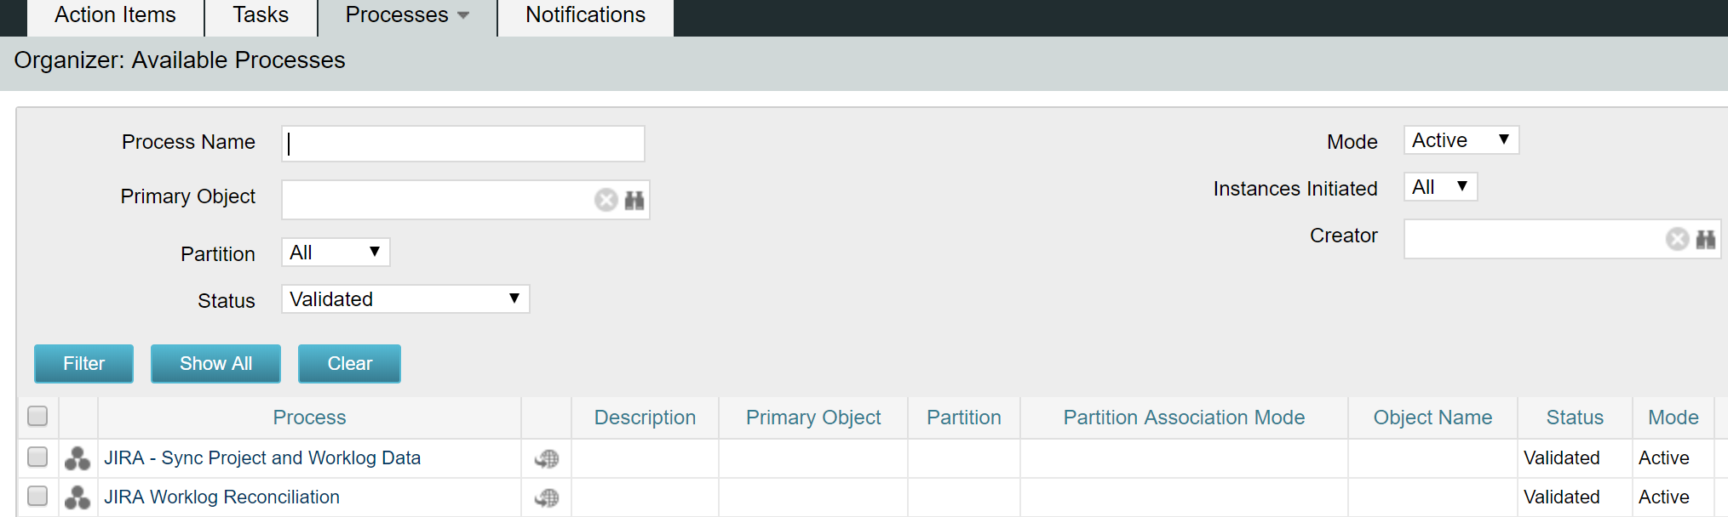
JIRA Integration - Processes
JIRA - Sync Project and Worklog Data – This process can be run manually or can be scheduled to run at different intervals during the day. This process syncs the issue and worklog data for all the projects marked for sync with JIRA.
JIRA Worklog Reconciliation – This process will be run the administrators to re-process the worklogs that have errored out in the past runs.

Slide 10
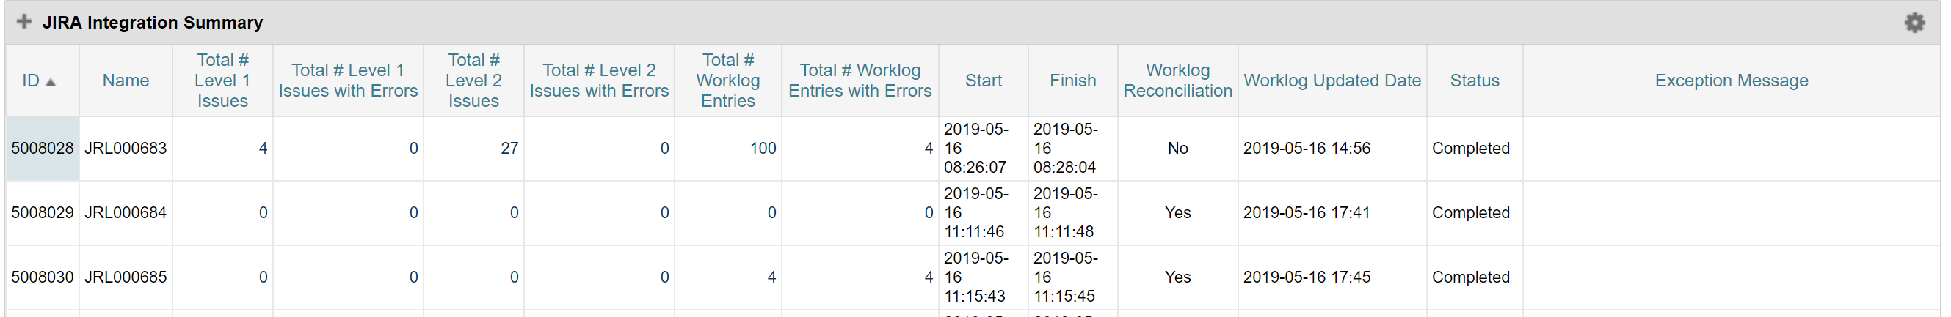
JIRA Integration portlets – Summary portlet
JIRA Integration Summary portlet displays the overall information of the data that is retrieved from JIRA and uploaded into PPM in every integration run.
Total number of issues and worklogs retrieved in the run and the number of records that have validation errors.
Start and end time of then run
Current state of the integration run
Any unexpected exception are recorded here

Slide 11
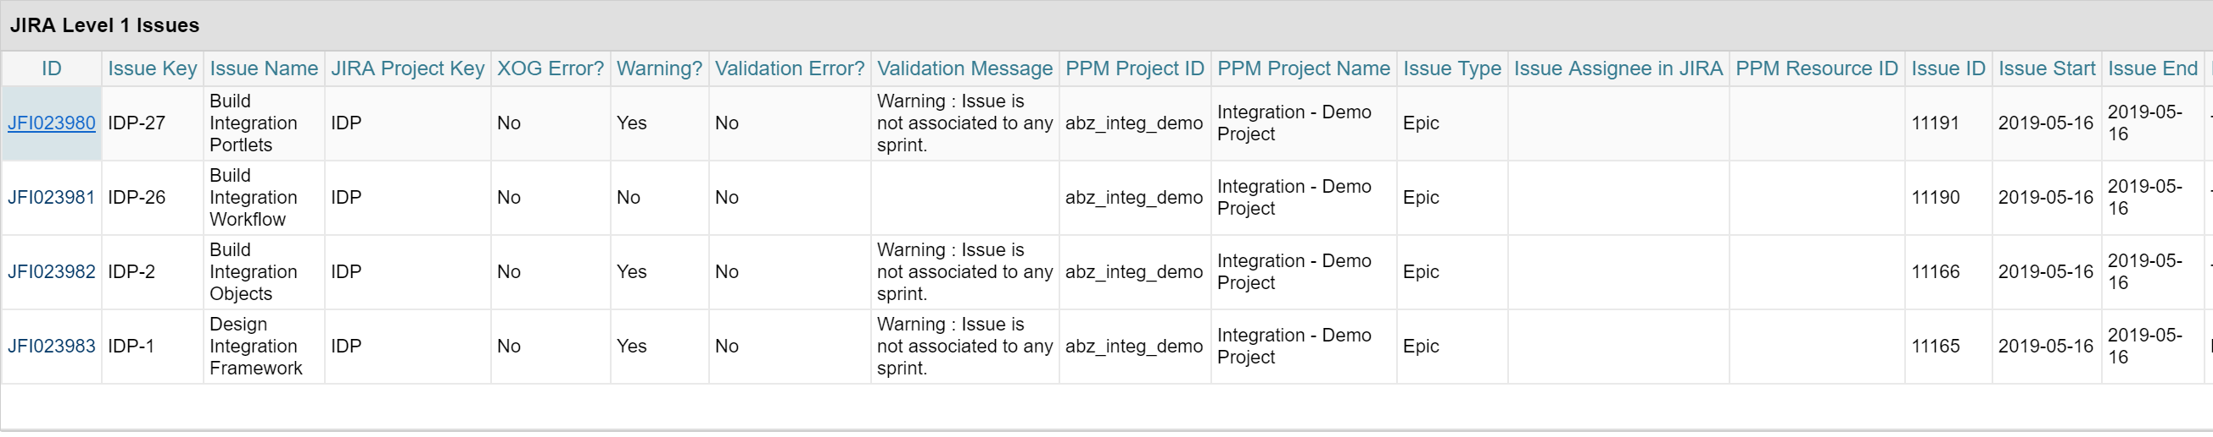
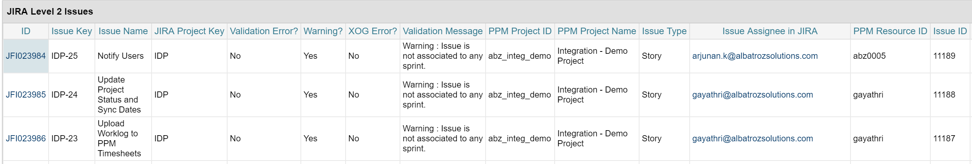
JIRA Integration portlets – Level 1 & Level 2 Issues
Clicking on Total # Issues on the summary portlet will redirect to the drill down portlets – JIRA Level 1 Issues and JIRA Level 2 Issues. These portlets list all the Level 1 and Level 2 issues retrieved in the corresponding integration run.
Issue Key and Issue ID uniquely identify each Issue retrieved from JIRA. All the other information retrieved corresponding to these issues are displayed in the portlets.

Slide 12
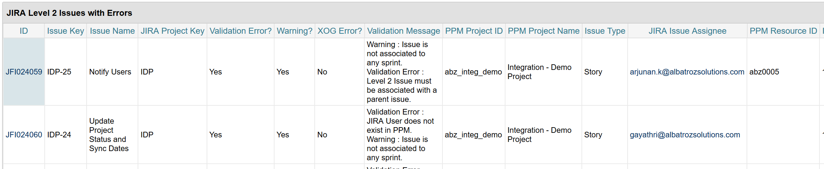
JIRA Integration portlets – Level 1 & Level 2 Error Issues
Clicking on Total # Issues with errors on the summary portlet will redirect to the drill down portlets – JIRA Level 1 Issues with errors and JIRA Level 2 Issues with errors.
These portlets display only those issues that have a validation error or xog error in the integration run. The validation/xog error field in the portlet will be marked as ‘Yes’ for these records and the error message is displayed in the Validation Message Column.

Slide 13
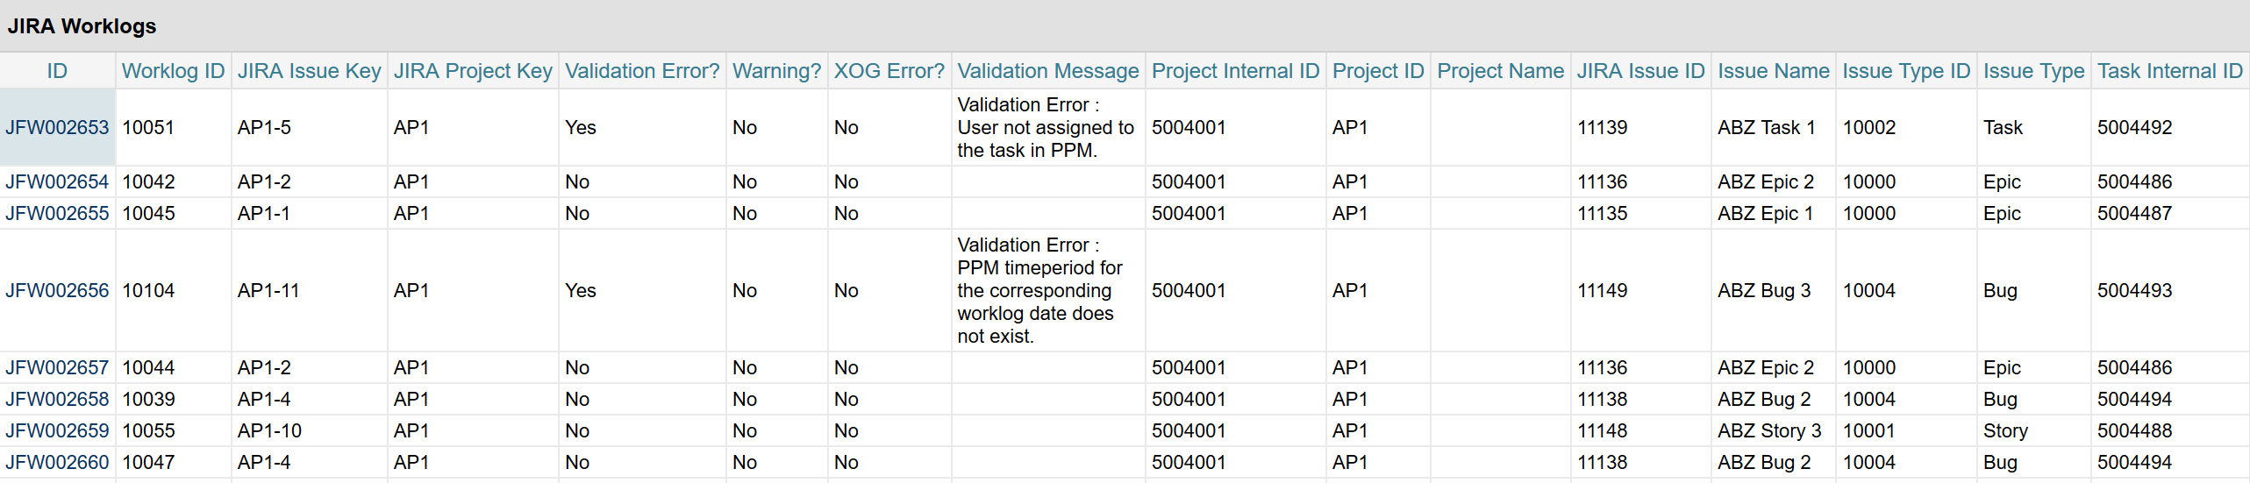
JIRA Integration portlets – Worklogs
Clicking on Total # Worklogs on the summary portlet will redirect to the drill down portlet – JIRA Worklogs. This portlet displays all the worklogs that are retrieved during the integration run along with other related information like project, task, resource etc.

Slide 14
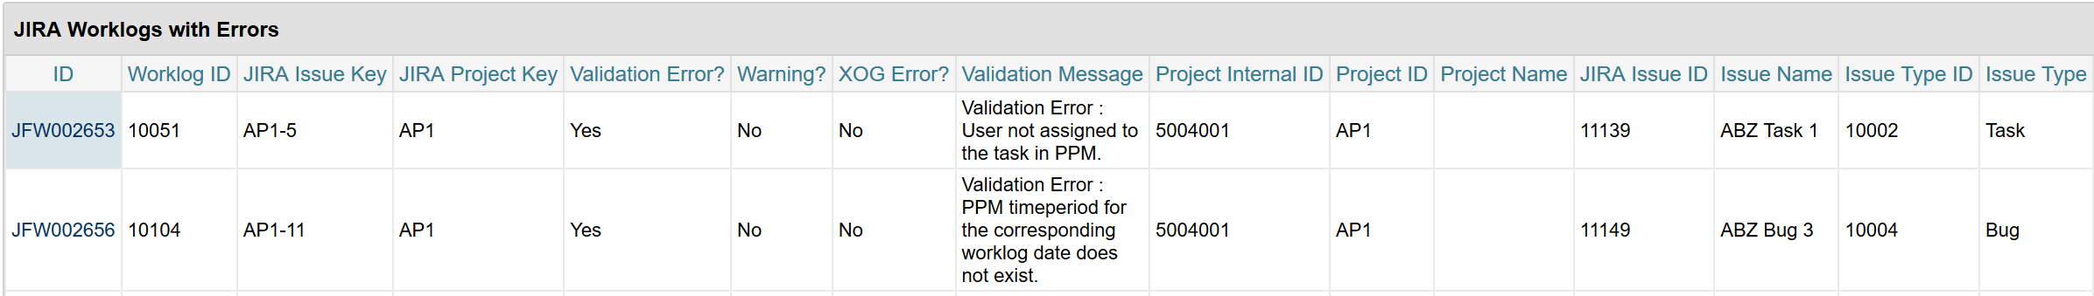
JIRA Integration portlets – Worklogs Errors
Clicking on Total # Worklogs Entries with Errors on the summary portlet will redirect to the drill down portlet – JIRA Worklogs with Errors. This portlet displays all the worklogs that have either validation error or XOG error.
The records in this portlet would have Validation/XOG error marked Yes and the appropriate error message is displayed in the Validation Message column.

Slide 15
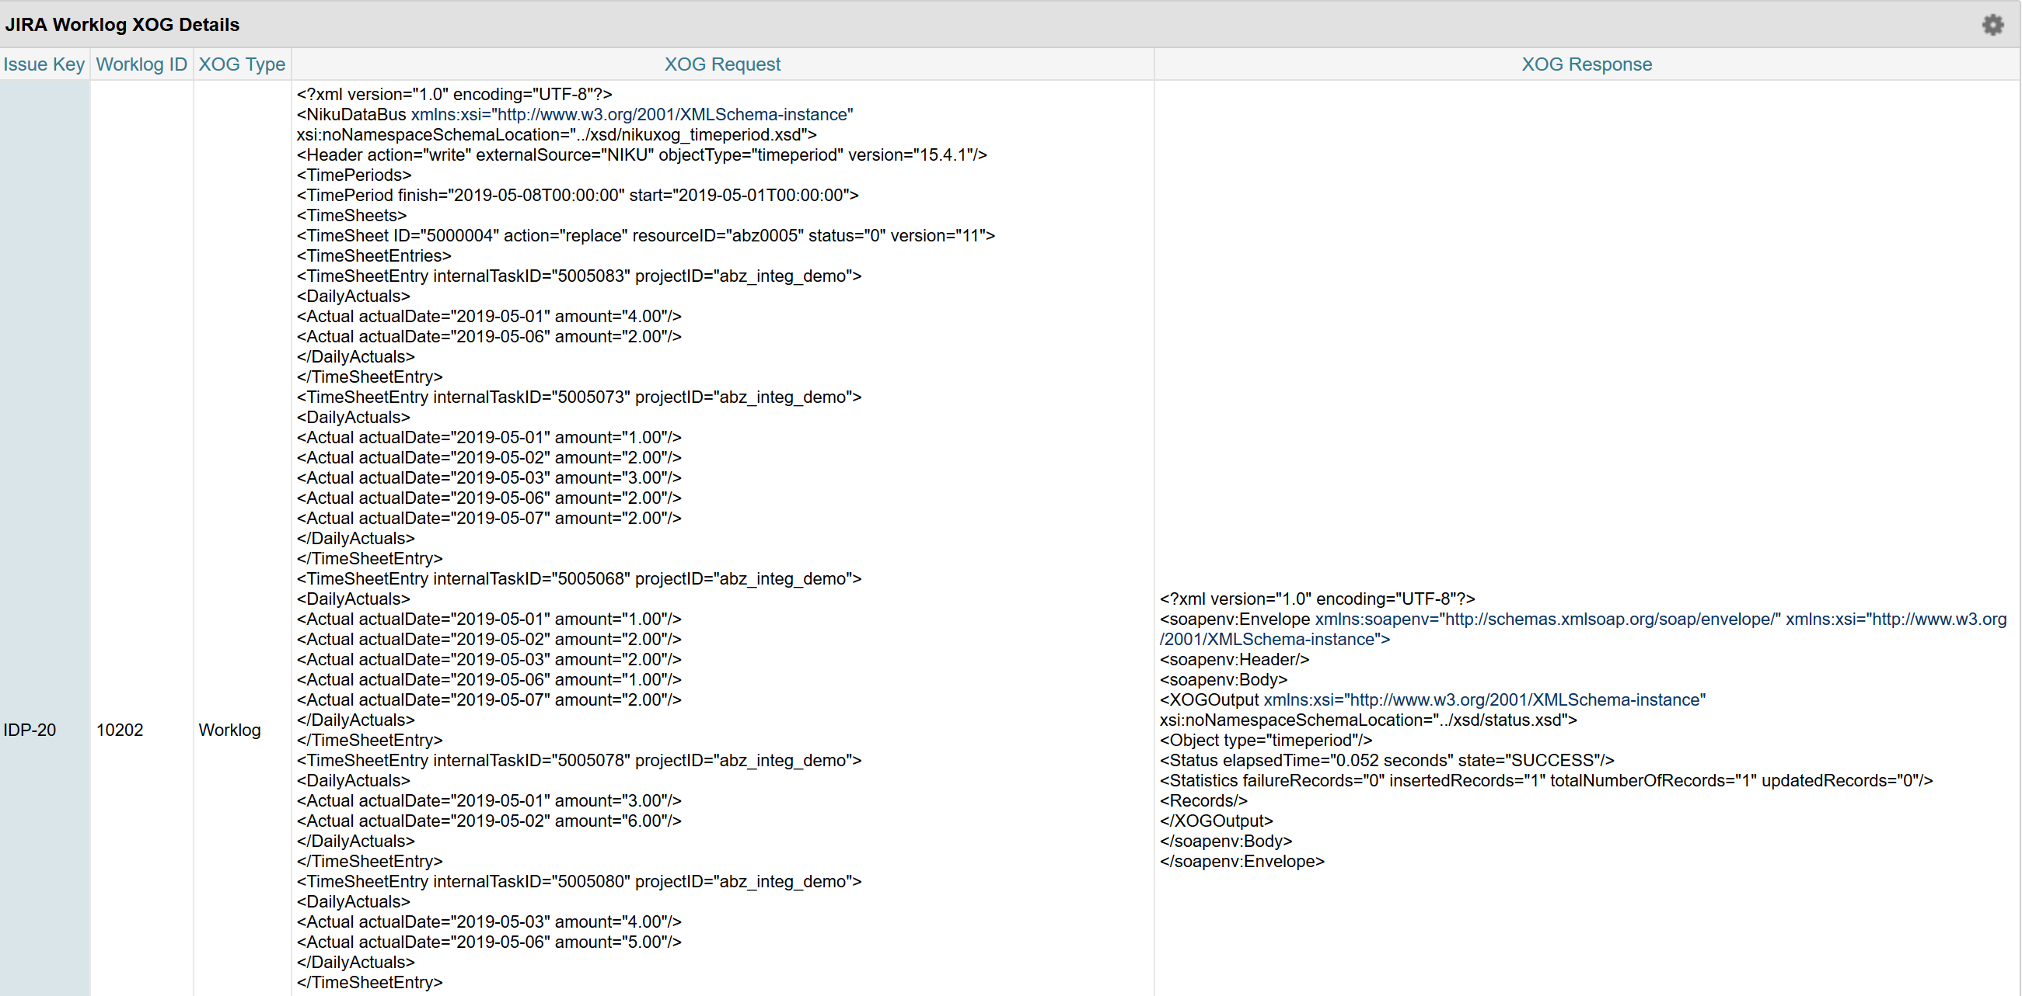
JIRA Integration portlets – XOG Request & Response
Click on the ID column in the Issues and Worklogs portlets will redirect to the XOG drill down portlet that store the XOG Request and Response corresponding to the data record. XOG Type represent the type of xog (team/task/assignment/worklog) and the request column stores the XOG xml sent to PPM and the response columns stores the XOG response received.

Slide 16
Appendix: Validation rules

Slide 17
Appendix: Objects
Jira Integration Configuration (abz_jira_intg_config) – Master JIRA Configuration object which stores the high level properties of the integration and is the parent object for the field mapping, translation, validation and xog objects.
Jira Field Mapping (abz_jira_field_mpng) – Sub object of ‘Jira Integration Configuration’ used to store the custom field definition that need to be retrieved from JIRA.
JIRA Translation (abz_jira_translation) – Sub object of ‘Jira Integration Configuration’ that is used to define the translation queries to modify the data retrieved from JIRA.
JIRA Validation (abz_jira_validation) – Sub object of ‘Jira Integration Configuration’ that is used to define the validation rules to verify the data retrieved from JIRA.
JIRA XOG (abz_jira_xog) – Sub object of ‘Jira Integration Configuration’ that is used to define the XOG templates used to upload the data into PPM.

Slide 18
Appendix: Objects
JIRA Integration Run Log (abz_jira_intg_runlog) – Master object that holds the summary information of every integration run.
JIRA Feed – Issues (abz_jira_feed_issues) – Sub object of ‘JIRA Integration Run Log’ used to store the issue data retrieved from JIRA.
JIRA Issue XOG Req/Res (abz_jira_xog_req_res) – Sub object of ‘JIRA Feed – Issues’ that is used to store the XOG request and response corresponding to the issues uploaded to PPM.
JIRA Feed – Worklog (jira_feed_worklog) – Sub object of ‘JIRA Integration Run Log’ that is used to store the worklog data retrieved from JIRA.
JIRA Worklog XOG Req/Res (abz_jira_wklog_xog) – Sub object of ‘JIRA Feed – Worklog’ that is used to store the XOG request and response corresponding to the worklogs uploaded to PPM.

